Slide 1
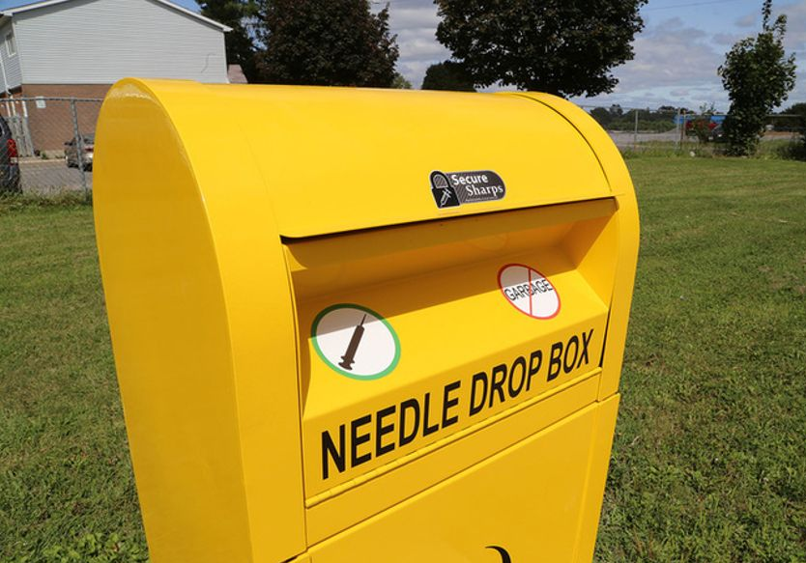


Community Sharps Kiosk
Let’s Keep Our Community Safe!
Michael Taylor, The Alliance Centre
Katharine O’Connell, North Bay Parry Sound District Health Unit
Tuesday, September 3, 2019

Slide 2
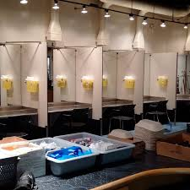
What is Harm Reduction?
Services, programs and philosophy proven to reduce the adverse health, social and economic consequences associated with substance use (both legal and illegal)
Reduces the impact on individual user and society
Evidence-based
Non-judgemental
Non-coercive
Client-centered
“meet them where they are”
Safe Injection Site
1

Slide 3
Importance of Harm Reduction
Does not encourage or increase substance use
Harm reduction programs, services and practices help reduce:
infectious diseases
overdoses and deaths
injection substance use in public places
number of used needles in public
sharing of needles and other substance use equipment
crime
Harm reduction programs, services and practices help increase:
employment among people who use substances
outreach and education
referrals to programs and services
2

Slide 4
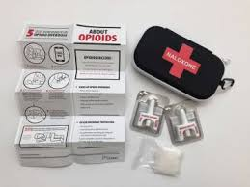
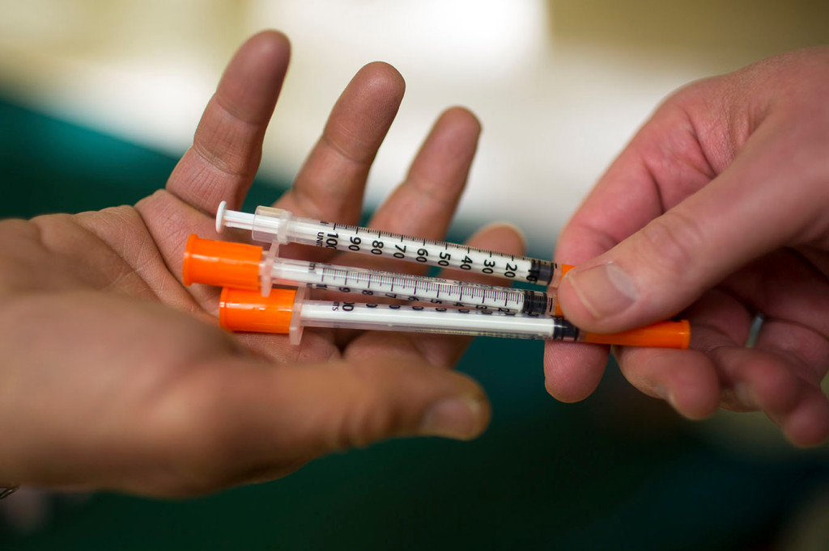
Examples of Harm Reduction Strategies
Examples could be, but not limited to:
nicotine patch
condoms/safe sex education
substance use education
medication assisted recovery (e.g. methadone)
needle exchange programs
naloxone kits
community sharps kiosks
Naloxone Kit
Needle Exchange Programs (NEPs)
3

Slide 5

Harm Reduction and Cost Savings
Treatment for Hepatitis C in Canada
$45,000 to more than $100,000 per fully-treated patient
Harm reduction interventions are good value for the money invested and improve health outcomes.
4

Slide 6

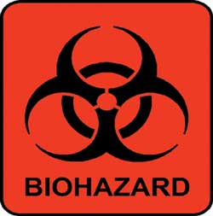
West Nipissing Needle Exchange Statistics
The Alliance Centre September 2018-Present
85
22,502
5,267
Biohazard Sharps Containers Distributed
Needles Out
Needles In
5

Slide 7

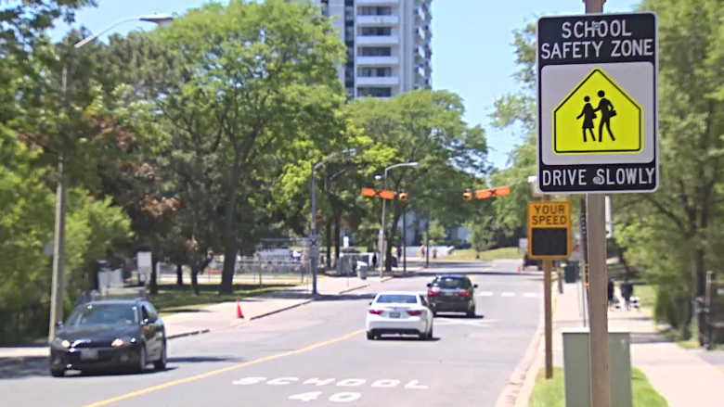
Substance Use is about People
Personal Safety
Community Safety

Slide 8
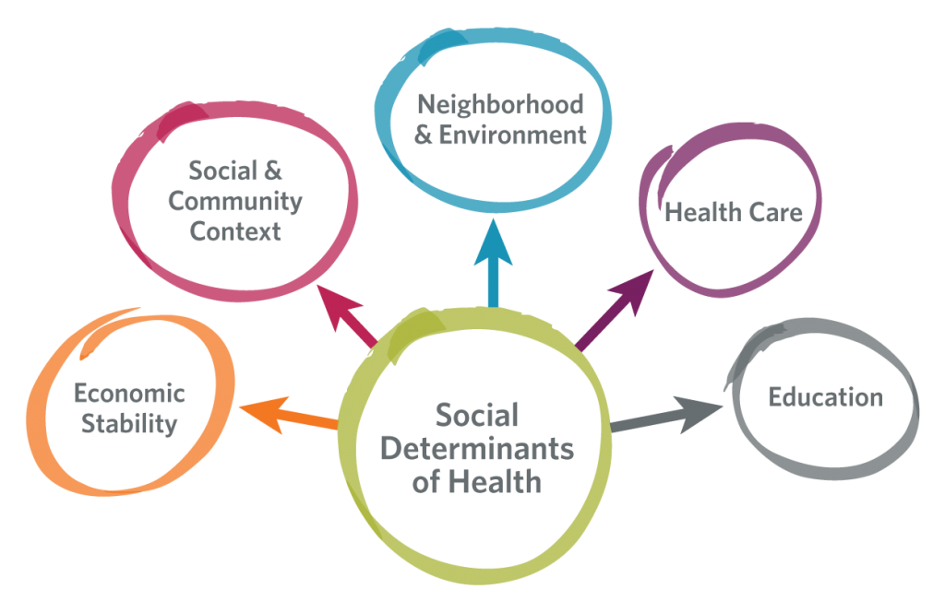
Substance Abuse A Public Health Issue
7

Slide 9
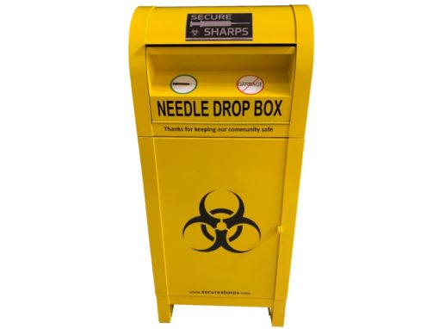
Community Sharps Kiosk
Promotes health equity
24/7 needle drop-off
Improves community safety and
protects children
Reduction in health care costs
Reduces stigma
8

Slide 10




Location and Installation
Survey
Group Discussion
City Approval
Bin Installation
9

Slide 11
Community Sharps Education
Two-pronged approach
Substance users
Posters
Word-of-mouth
Harm reduction kits
FAQ
Testing drive event
General public
Posters
Radio ads
10

Slide 12
Community Sharps Bin Logistics
Maintenance
Garbage
Needle disposal
Shoveling and salting
Reporting
Sharps pick-up
Approximate total annual cost to Municipality of West Nipissing for projected bi-weekly pick up, disposal and maintenance
$7,251.86 to $11,243.38
11

Slide 13
Summary of Tasks and Associated Costs
Item | Health Unit, ACNBA, The Alliance Centre and CCC | Municipality of West Nipissing
Bin Location and Installation | Purchase community sharps kiosk ($2,660) Survey local substance users about location of bin Facilitate group session with individuals with lived experience Approve location with city Contact ECS Cares to install bin when ready Pay for bin installation ($125) | Cement slab ($250 plus tax) Install garbage can near community sharps bin (cost TBD)
Sharps Kiosk Education | Posters Harm reduction kits FAQ information Testing drive ($300) | Radio ads ($500-$800)
Sharps Kiosk Maintenance Pick-up and Disposal | Determine agency to maintain bin Negotiate contract with needle disposal company (and pass onto city) | Funding for bin maintenance (2x a week=$0-$3,008.20) OR assign city workers Provide funding for sharps pick-up and disposal costs ($6,800-$7,800)* Equipment and supplies/PPE ($450)
*Based on bi-weekly pick-up. This could change depending on use of bin.
12

Slide 14

Questions
13

Slide 15
References
British Columbia Ministry of Mental Health and Addictions. (2019). Opioid overdose crisis campaign assets. Retrieved from https://tractioncreative-my.sharepoint.com/:b:/p/jefflucas/EUem8MYWuyZPgYV477MIZBkBzGfTiuALMRnX7KZG6zG05Q?e=4%3arsCh0Z&at=9 on July 8th, 2019.
Canadian Centre on Substance Abuse. (n.d.). Needle exchange programs (NEPs) FAQs. Retrieved from https://www.ccsa.ca/sites/default/files/2019-04/ccsa-010055-2004.pdf on August 26, 2019.
Canadian Mental Health Association. (2019). Harm reduction. Retrieved from https://ontario.cmha.ca/harm-reduction/ on August 12, 2019.
HealthLinkBC. (2015). Understanding harm reduction: Substance use. Retrieved from https://www.healthlinkbc.ca/healthlinkbc-files/substance-use-harm-reduction on August 12, 2019.
Toronto Public Health. (2018). Needle disposal: Guidance for policies and procedures. Retrieved from https://www.toronto.ca/wp-content/uploads/2018/12/8dbc-Needle-Disposal-Guidance.pdf on August 12, 2019.
UPMC Enterprises. (2019). The impact of social determinants of health. Retrieved from https://enterprises.upmc.com/blog/social-determinants-of-health/ on August 26, 2019.
Webster, P. (2017). Secrecy on cost of publically funded hep C treatment. Canadian Medical Association Journal, 189 (16), E617-618.

